Slide 2

Ypp 4
bbv Software Services AG | Date: 21/07/2025

Slide 3




Presentation on MS Lists Functionalities
bbv Software Services AG | Date: 21/07/2025

Slide 4
Agenda
Introduction
Key Functionalities
Q&A

Slide 5

Introduction
What is MS Lists?

Slide 6
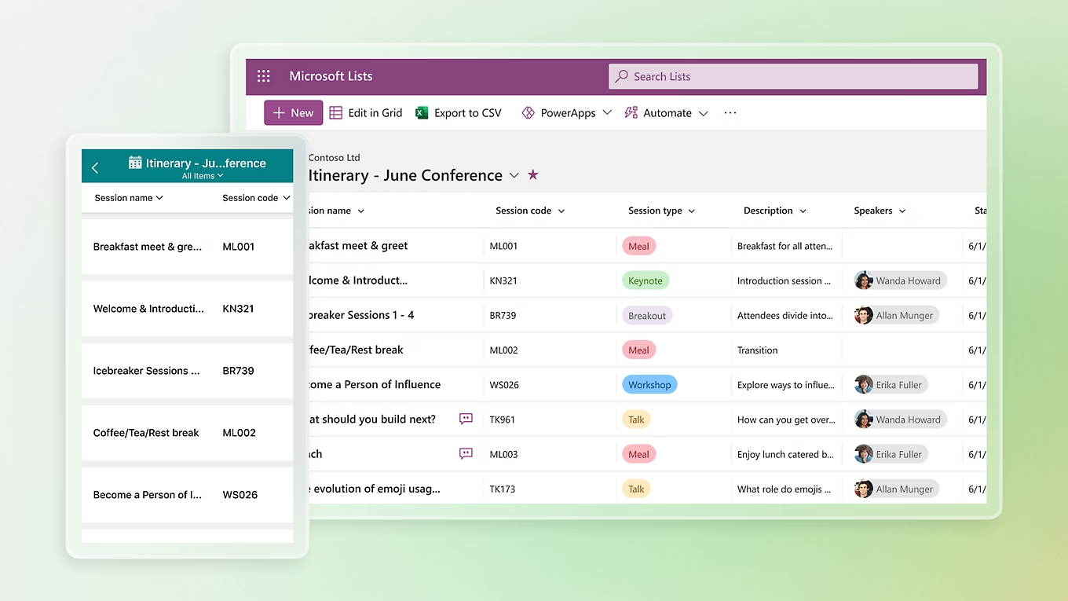
Introduction
What is Microsoft Lists
MS List is a tool for managing structured lists of data
Works like a simple table or database
Let’s users:
Create lists
View data
Manage info clearly and easily

Slide 7

Key Functionalitie

Slide 8
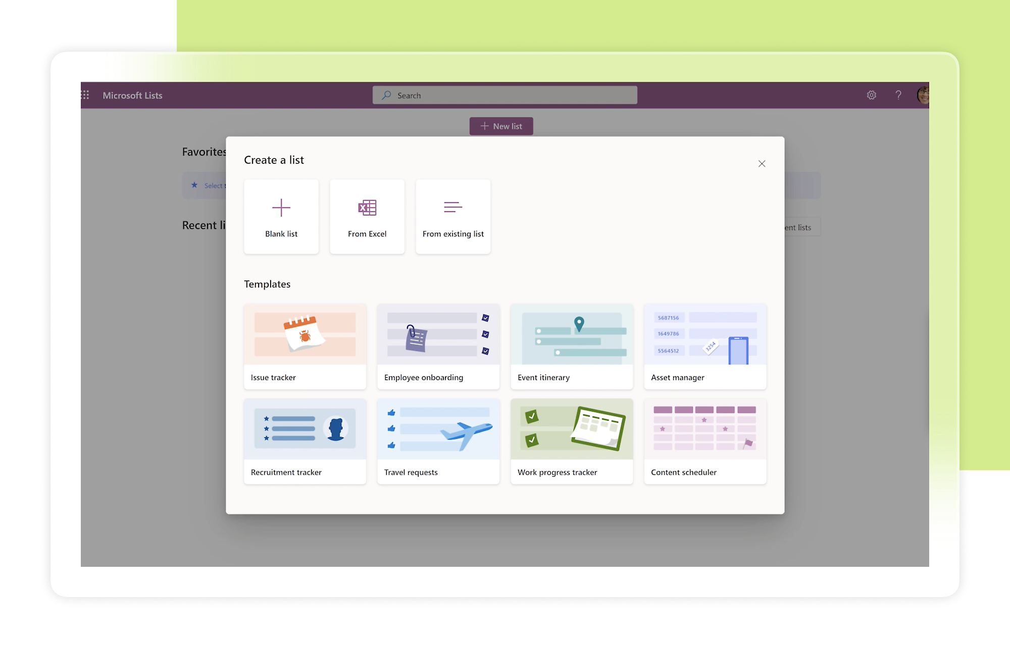
Key Functionalities of MS Lists
Create and Manage Lists
Custom Columns
Manage List Items
Custom Views
Conditional Formatting
Permissions and Sharing
Built-in Templates

Slide 9
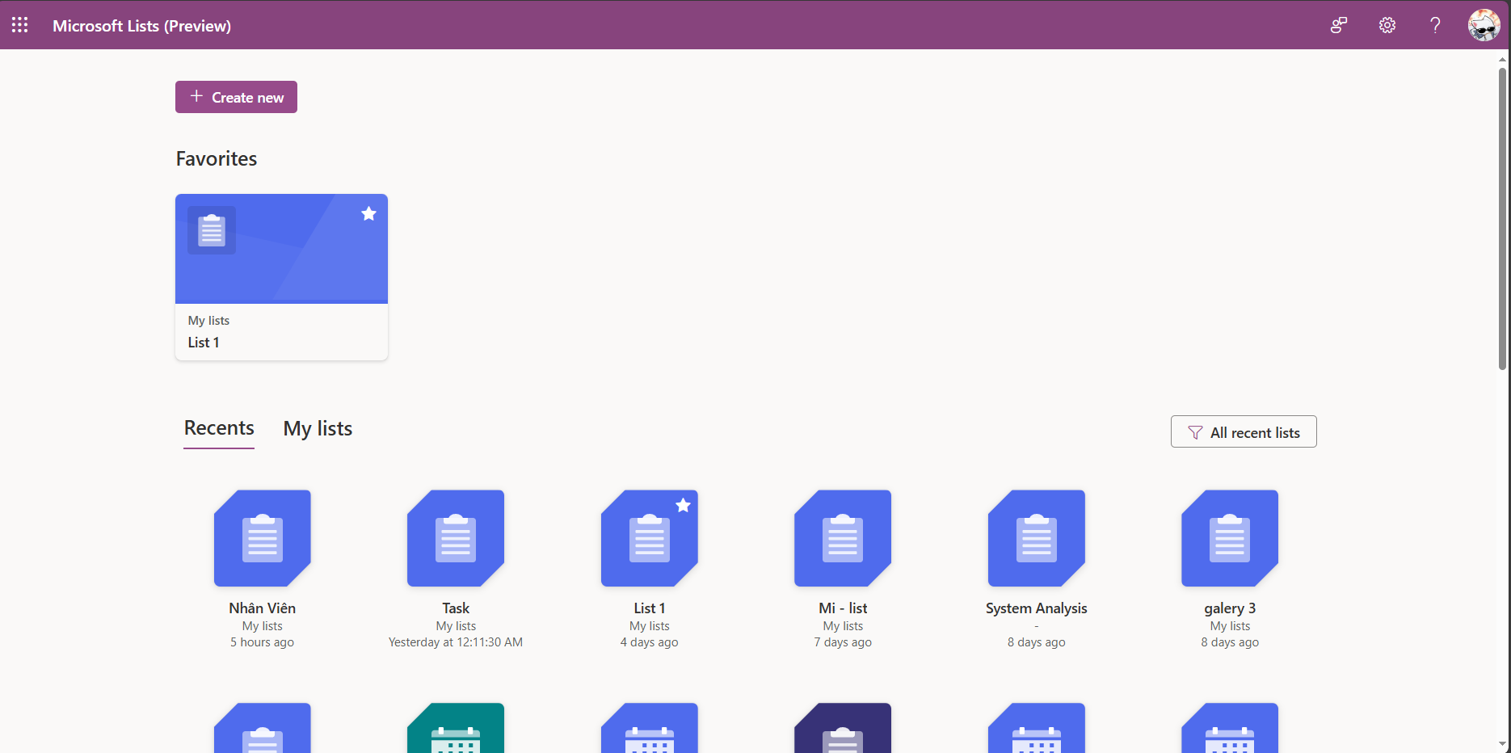
Dashboard Screen
FavoriteList
RecentList
List
ListName
WorkspaceId
Icon
Color
LastAccessedAt
Notes:
-- 1. Display all lists that the logged-in user created or were shared with them
DECLARE @UserId INT = 2; -- Replace with the ID of the logged-in user
SELECT DISTINCT
l.Id,
l.ListName,
l.Icon,
l.Color,
lmp.HighestPermissionCode, -- Extra
lmp.GrantedByAccountId -- Extra
FROM List l
JOIN ListMemberPermission lmp ON l.Id = lmp.ListId AND lmp.AccountId = @UserId -- JOIN is still used because the creator will be added to ListMemberPermission
WHERE l.CreatedBy = @UserId
OR lmp.Id IS NOT NULL
AND l.ListStatus = 'Active';
GO
-- 2. Display all lists that the logged-in user created
DECLARE @UserId INT = 2;
SELECT
l.ListName,
l.Icon,
l.Color
FROM List l
WHERE l.CreatedBy = @UserId
AND l.ListStatus = 'Active';
GO
-- 4. Display favorite lists of the logged-in user
DECLARE @UserId INT = 2; -- Replace with the ID of the logged-in user
SELECT
l.Id,
l.ListName,
l.Icon,
l.Color
FROM FavoriteList fl
INNER JOIN List l ON fl.ListId = l.Id
WHERE fl.FavoriteListOfUser = @UserId
AND l.ListStatus = 'Active'
ORDER BY fl.CreatedAt DESC;
GO

Slide 10
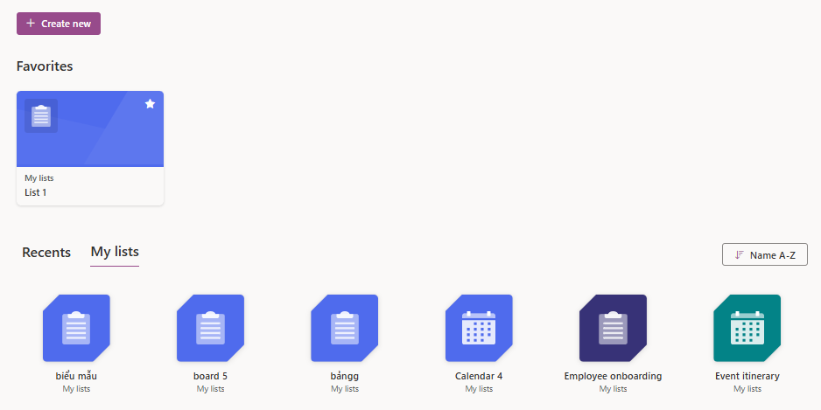
Dashboard Screen
Workspace
Workspace. WorkspaceName
Workspace. IsPersonal = true

Slide 11
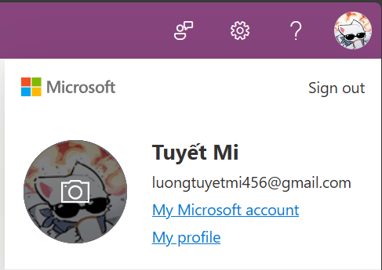
Dashboard Screen
Account
Account.FirstName
Account.LastName
Account.Avatar
Account.Email
Notes:
-- 3. Display information of the logged-in user
DECLARE @UserId INT = 2;
SELECT
a.Id,
a.FirstName,
a.LastName,
a.Avatar,
a.Email,
a.Company,
a.AccountStatus
FROM Account a
WHERE a.Id = @UserId;
GO

Slide 12
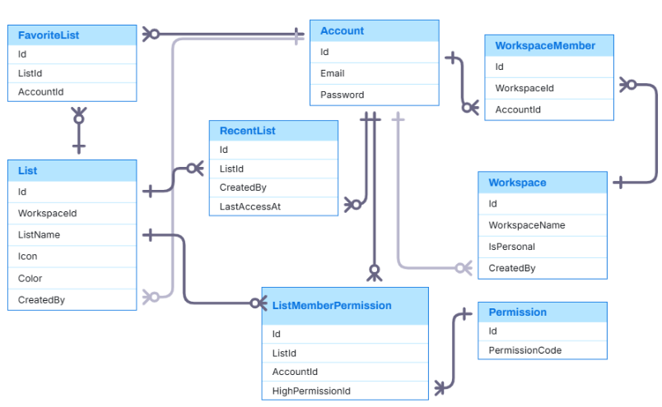
Entity Relationship

Slide 13
Dashboard Sample Data

Slide 14
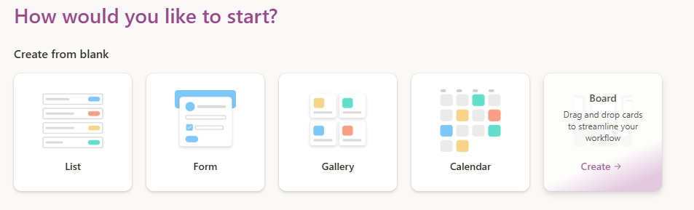
Create List Screen
ListType
ListType.Title
ListType. ListTypeDescription
ListType.HeaderImage
Notes:
-- 1. Display all list types for selection
SELECT
Title,
ListTypeDescription,
HeaderImage
FROM ListType
ORDER BY Title;

Slide 15
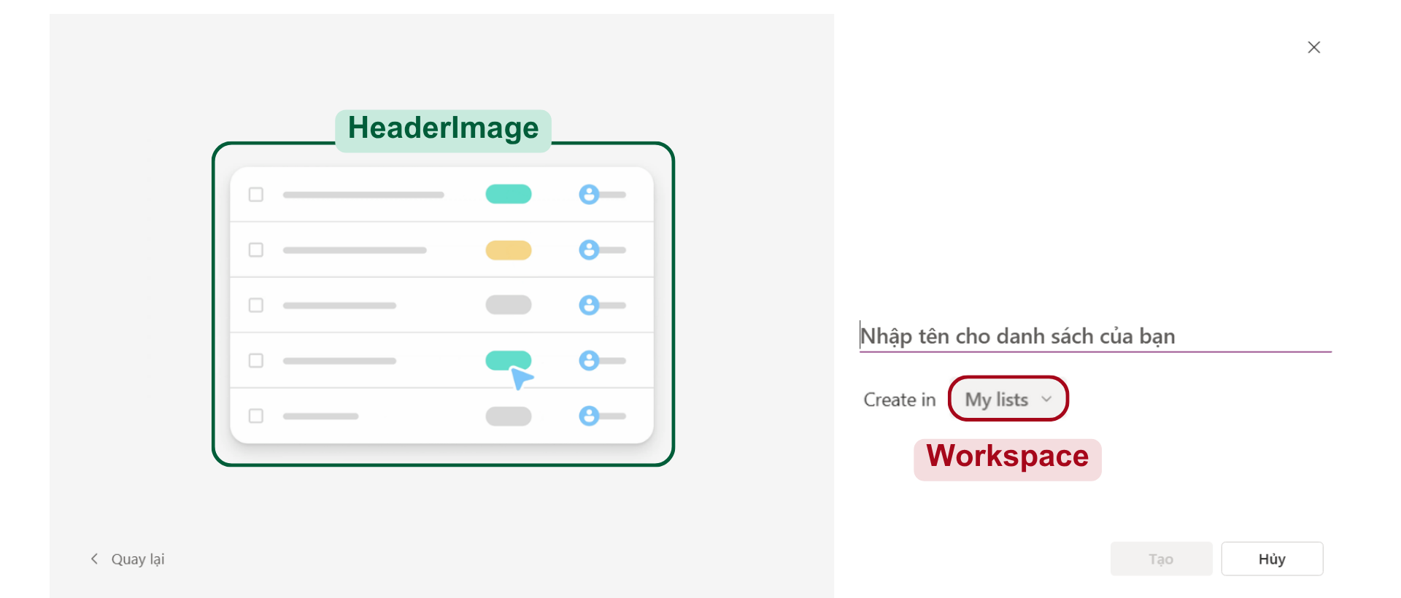
Create List From List Type
List
ListType
List.ListName

Slide 16
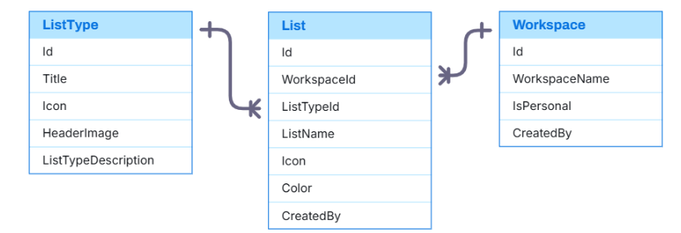
Entity Relationship

Slide 17
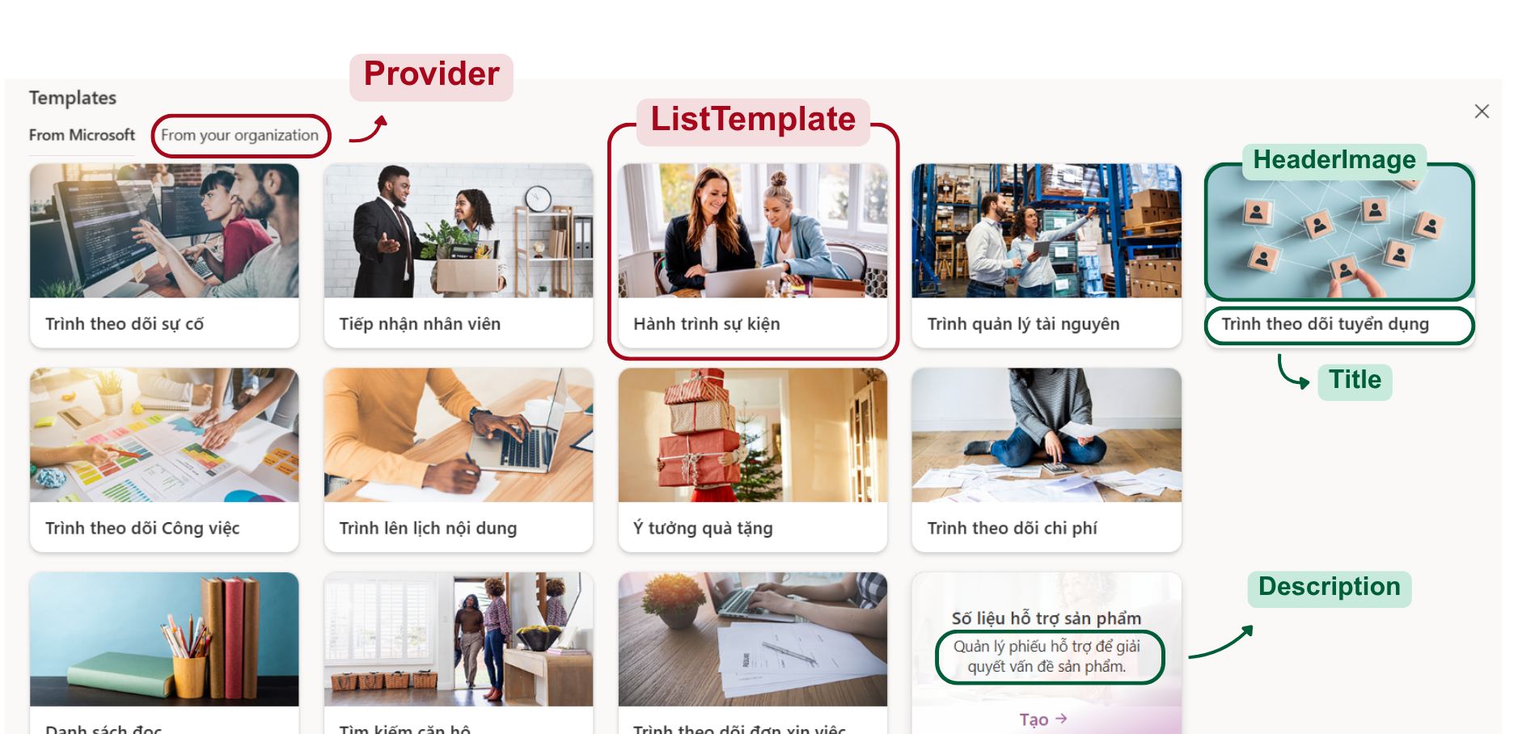
Create List Screen
Notes:
-- 2. Display all templates
SELECT
lt.Title,
lt.HeaderImage,
lt.Sumary,
pr. ProviderName
FROM ListTemplate lt
JOIN Provider pr ON lt.ProviderId = pr.Id
ORDER BY lt.Title;

Slide 18
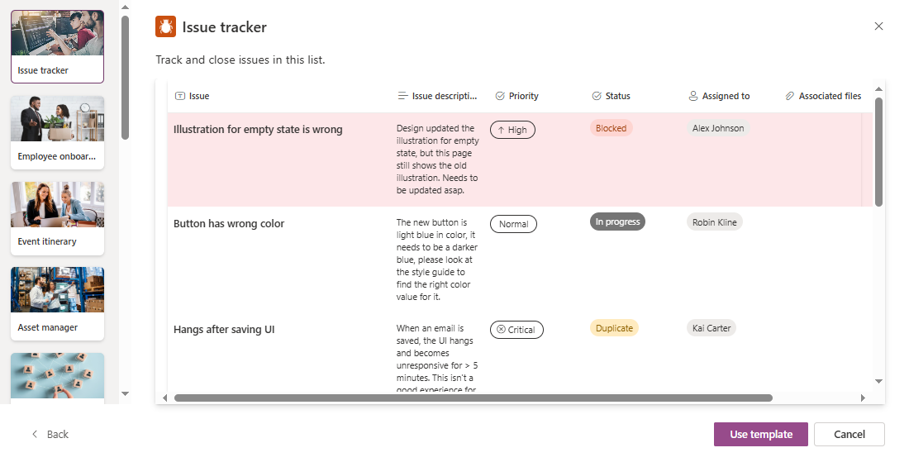
List Template
ListTemplate
ListTemplate.Icon / Color / Title
TemplateView
ListTemplate.TemplateDescription

Slide 19
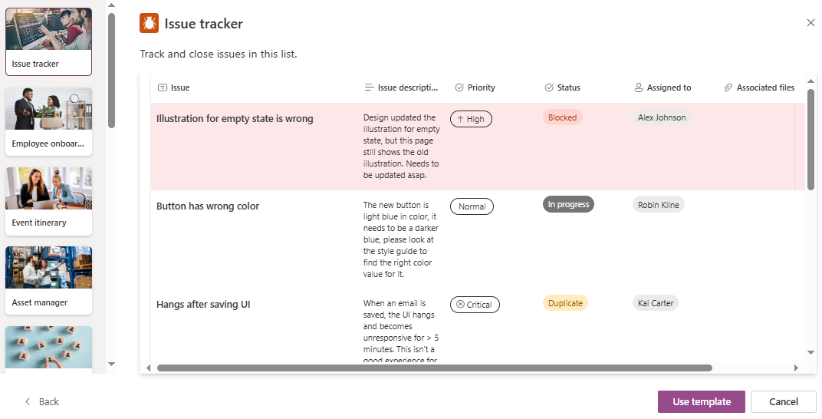
List Template
TemplateColumn
TemplateColumn. Icon / ColumnName
TemplateCellValue
TemplateRow

Slide 20
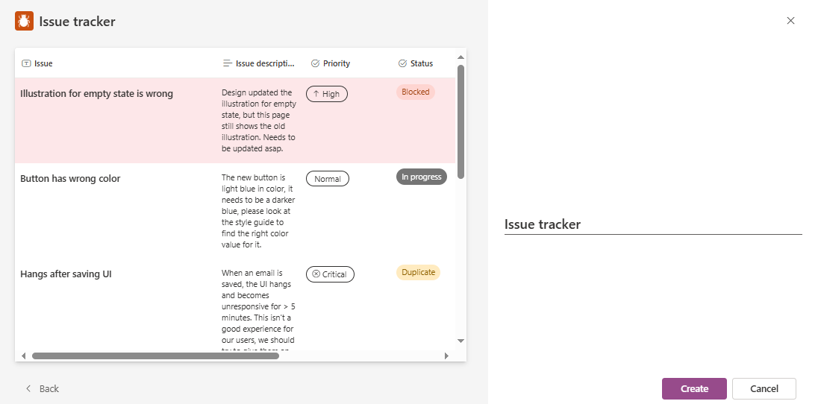
Create List from Template
List
ListTemplate
List.ListName

Slide 21
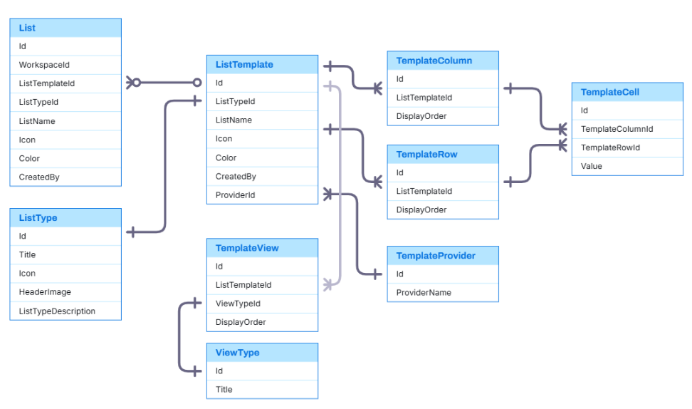
Entity Relationship

Slide 22
Create List Sample Data

Slide 23
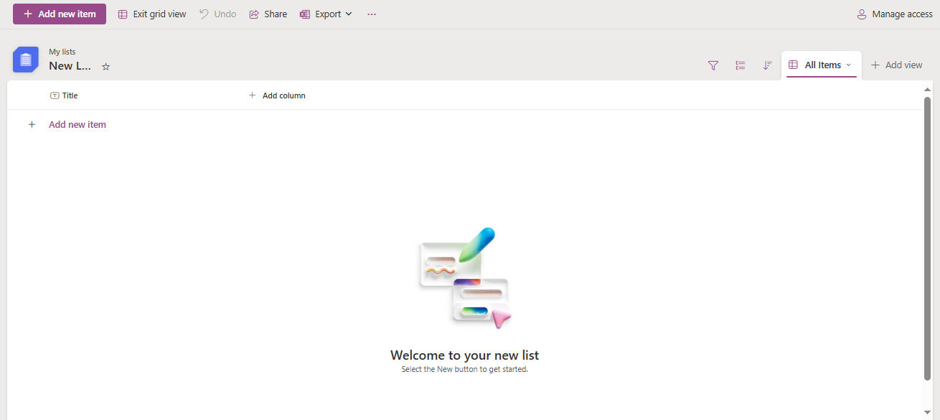
List

Slide 24
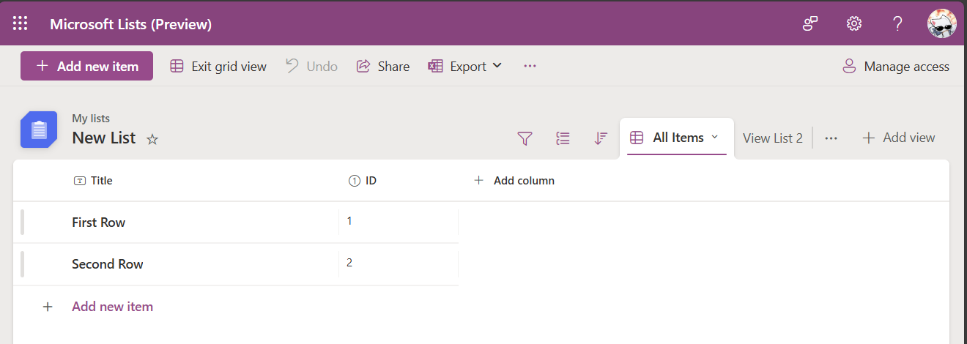
List
ListTemplate
List
List.ListName
List.WorkspaceId
List.Color
List.Icon
FavoriteList.Listid
ListDynamicColumn
ListView
ListRow
CellValue

Slide 25
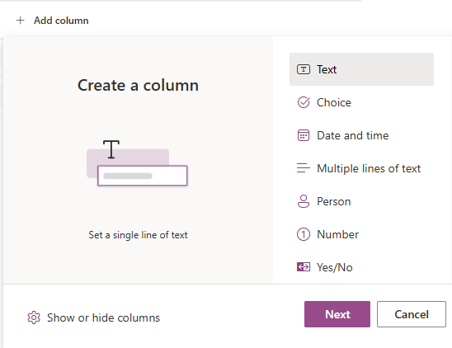
Dynamic Column
SystemDataType
SystemDataType.Icon
SystemDataType. DisplayName
SystemDataType.CoverImg
SystemDataType.DataDiscription
ListDynamicColumn

Slide 26
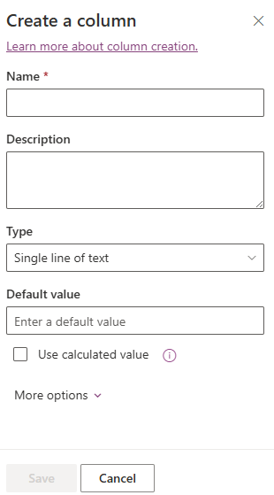
Create Dynamic Column
ListDynamicColumn
n
ListDynamicColumn.ColumnName
ListDynamicColumn.ColumnDescription
1
SystemDataType

Slide 27
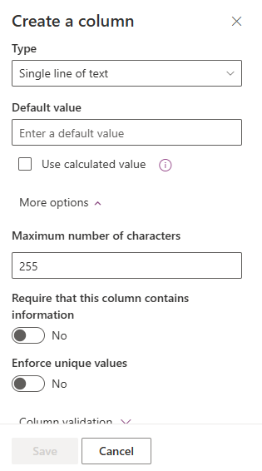
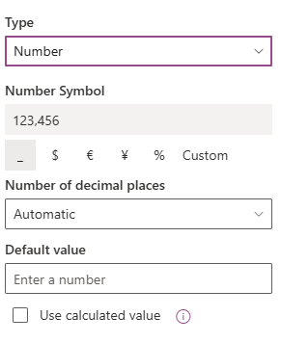
Create Dynamic Column
ListDynamicColumn
SystemDataType
1
n
DataSettingKey
n
1
KeySetting
KeySetting.KeyName
KeySetting.ValueType (e.x: Text. Number, Boolean,…)

Slide 28
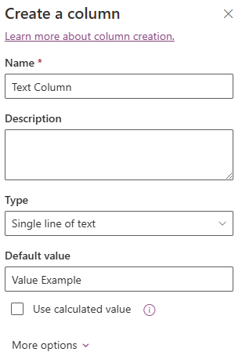
DataTypeSettingKey
ListDynamicColumn
DataSettingKey.SystemDataType
DataSettingKey.KeySetting
DataSettingKey
DataSettingKey. KeyValue

Slide 30
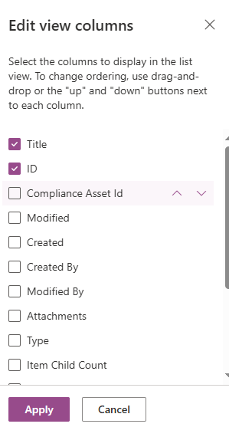
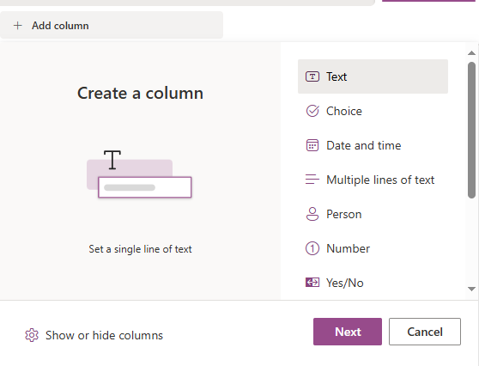
SystemColumn
Each list will have default columns based on system columns, and these columns can be hidden depending on the view.
ListViewColumn
ListDynamicColumn.Name
ListViewColumn.IsVisible
ListViewColumn. DisplayOrder

Slide 31
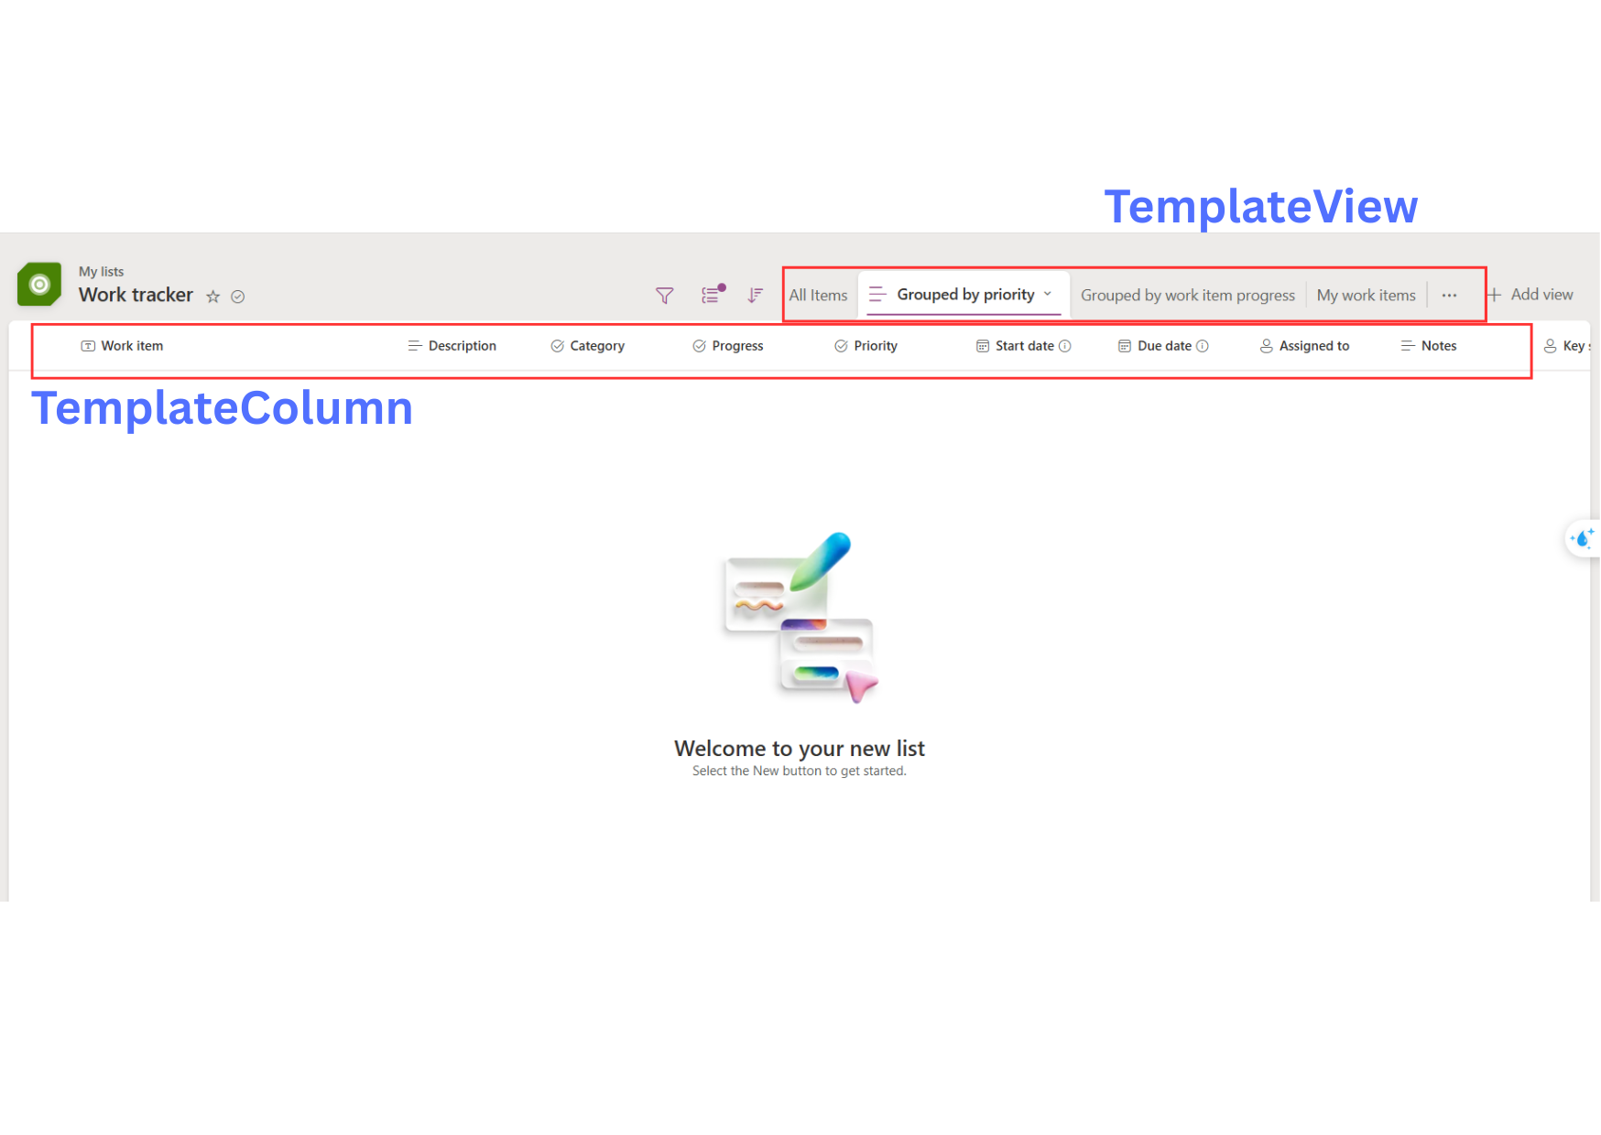
Template View & Template Column

Slide 32
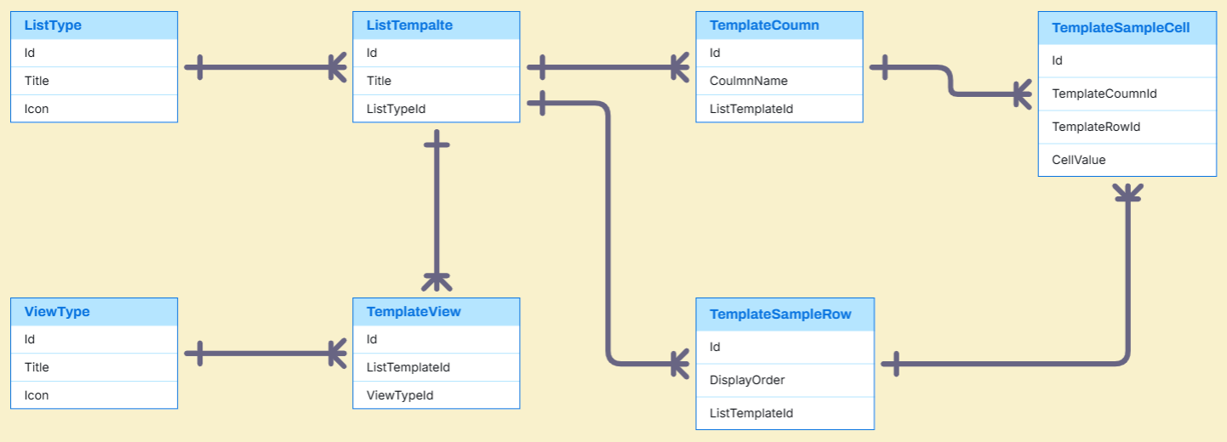
Template Entities

Slide 33
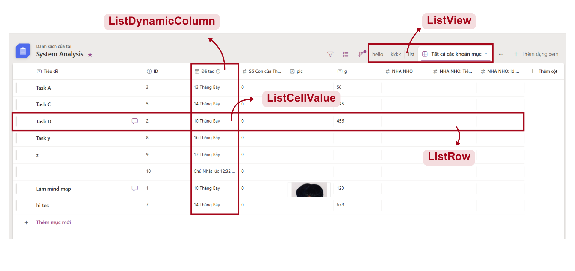
List Management
Notes:
DECLARE @UserId INT = 2;
DECLARE @ListId INT = 2;
-- Check access permission
IF EXISTS (
SELECT 1
FROM ListMemberPermission
WHERE ListId = @ListId AND AccountId = @UserId
)
BEGIN
-- User has access: show list info
SELECT
l.Id AS ListId,
l.ListName,
CASE
WHEN l.CreatedBy = @UserId THEN 'My List'
ELSE NULL
END AS Ownership,
CASE
WHEN f.Id IS NOT NULL THEN 'Yes'
ELSE 'No'
END AS IsFavorite,
'Has access' AS AccessStatus
FROM List l
LEFT JOIN FavoriteList f
ON l.Id = f.ListId AND f.FavoriteListOfUser = @UserId
WHERE l.Id = @ListId;
END
ELSE
BEGIN
-- User has no access: return notice
SELECT
NULL AS ListId,
NULL AS ListName,
NULL AS Ownership,
NULL AS IsFavorite,
'No access' AS AccessStatus;
END
GO
-- 2. Display all list views of the selected list
DECLARE @UserId INT = 2;
DECLARE @ListId INT = 2;
-- Check if the user has access
IF EXISTS (
SELECT 1
FROM ListMemberPermission
WHERE ListId = @ListId AND AccountId = @UserId
)
BEGIN
-- User has access: show all views of the list
SELECT
lv.Id,
lv.ListId,
lv.ViewName,
lv.DisplayOrder
FROM ListView lv
WHERE lv.ListId = @ListId
ORDER BY lv.DisplayOrder;
END
ELSE
BEGIN
-- User has no access
SELECT
NULL AS ListViewId,
NULL AS ViewName,
NULL AS ViewType,
NULL AS DisplayOrder,
NULL AS IsDefault,
NULL AS CreatedAt,
'No access to this list' AS AccessStatus;
END
GO -- 3. Display visible Dynamic Columns
DECLARE @ListId INT = 2;
SELECT
sd.Icon,
dc.ColumnName,
dc.IsVisible,
dc.DisplayOrder
FROM ListDynamicColumn dc
JOIN SystemDataType sd ON dc.SystemDataTypeId = sd.Id
WHERE dc.ListId = @ListId
AND dc.IsVisible = 1
ORDER BY dc.DisplayOrder;
GO

Slide 34
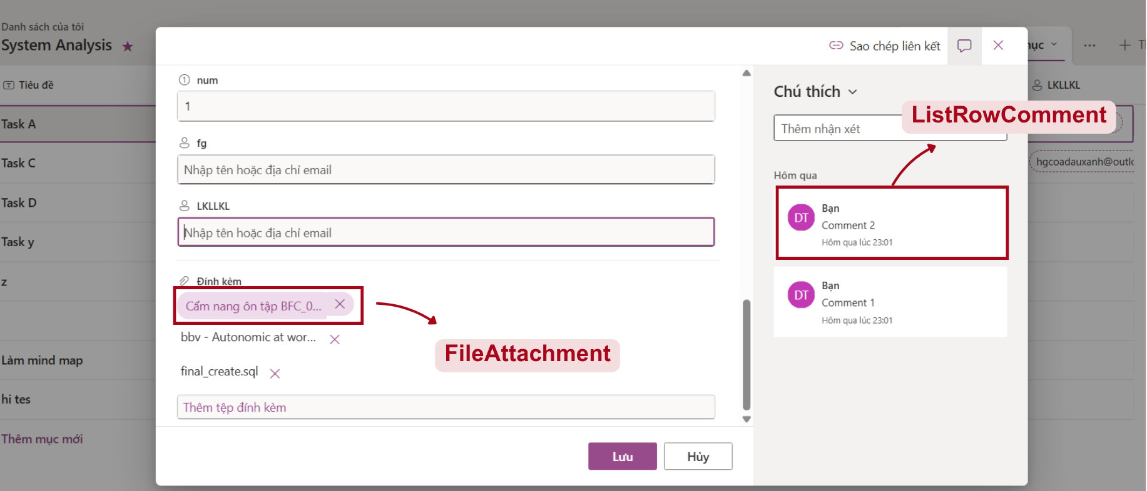
List Row Detail
Notes:
-- 1. Display the cell values for each column of the specified list row
DECLARE @ListId INT = 1;
DECLARE @ListRow INT = 1;
SELECT
ldc.ColumnName,
lcv.CellValue
FROM ListCellValue lcv
JOIN ListDynamicColumn ldc ON lcv.ListColumnId = ldc.Id
JOIN ListRow lr ON lcv.ListRowId = lr.Id
WHERE lr.Id = @ListRow
AND lr.ListId = @ListId -- đảm bảo đúng row thuộc list đó
AND ldc.ListId = @ListId -- chỉ lấy cột của list này
ORDER BY ldc.DisplayOrder;
GO
-- 2. Display the comments associated with that list row
DECLARE @ListId INT = 1;
DECLARE @ListRow INT = 1;
SELECT
a.FirstName,
a.Avatar,
lrc.Content,
lrc.CreatedAt
FROM ListRowComment lrc
JOIN Account a ON lrc.CreatedBy = a.Id
WHERE lrc.ListRowId = @ListRow

Slide 35
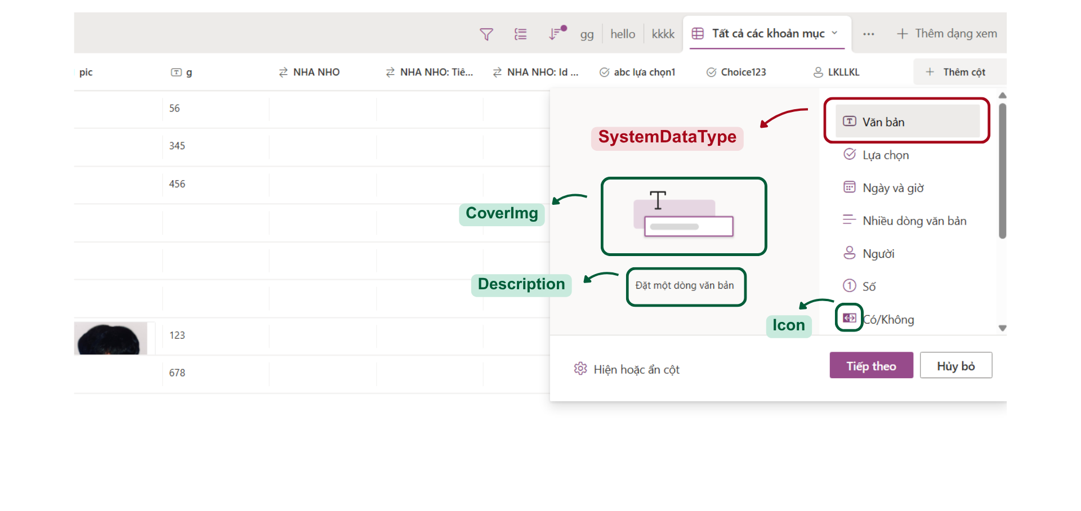
List Column
Notes:
-- 1. Display all Data Types of the Column.
SELECT
sd.CoverImg,
sd.DataTypeDescription,
sd.Icon,
sd.DisplayName
FROM SystemDataType sd
GO

Slide 36
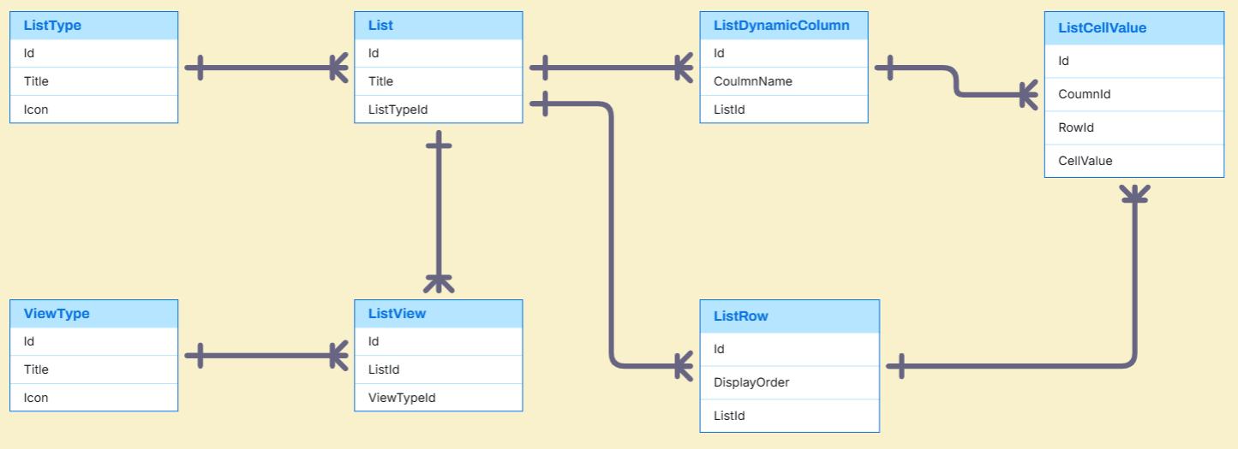
List Entities

Slide 37
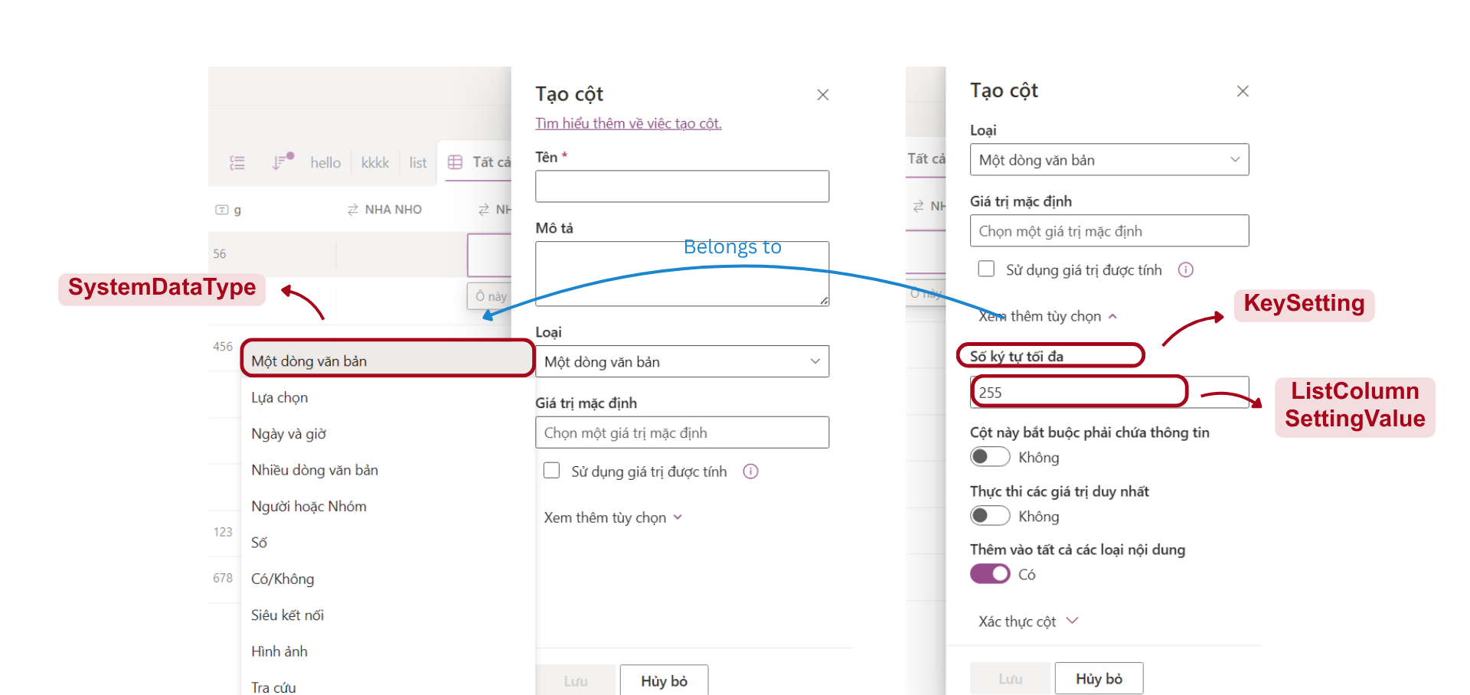
List Column Setting
Notes:
-- 2. Display Key Settings corresponding to that Data Type.
DECLARE @SystemDataTypeId INT = 1;
SELECT
sd.DisplayName,
ks.KeyName,
ks.ValueType
FROM KeySetting ks
JOIN DataTypeSettingKey dsk ON ks.Id = dsk.KeySettingId
JOIN SystemDataType sd ON dsk.SystemDataTypeId = sd.Id
WHERE dsk.SystemDataTypeId = @SystemDataTypeId
GO

Slide 38
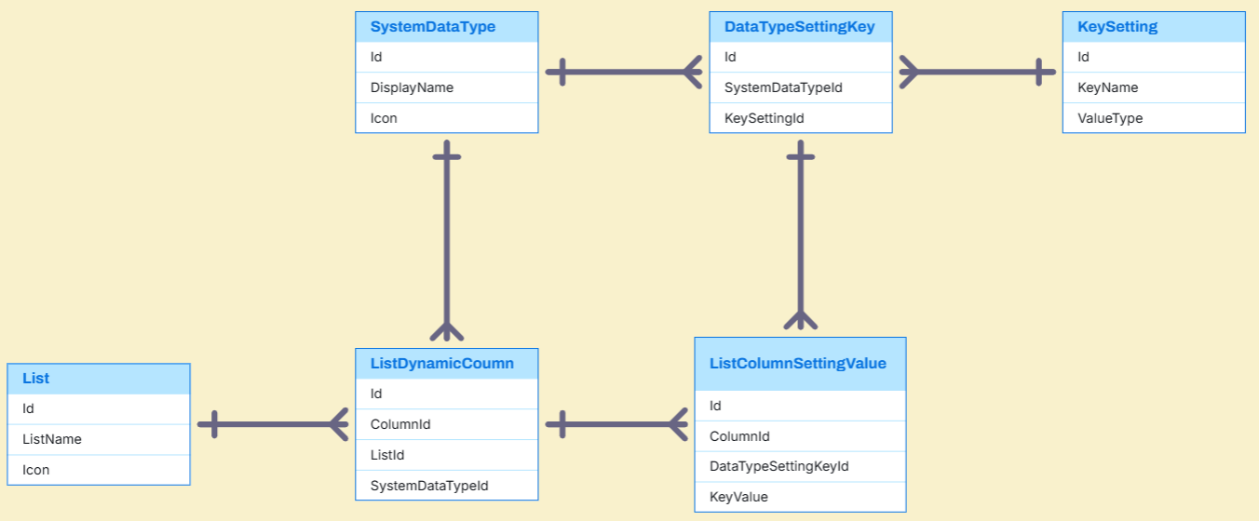
List Column Setting Entities

Slide 39
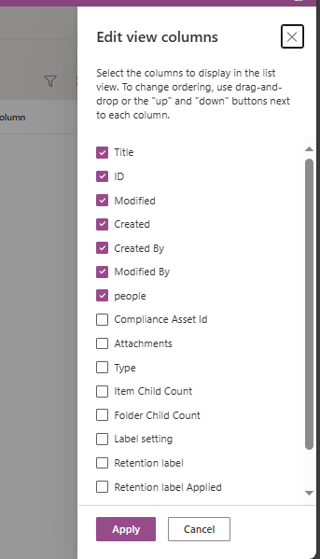
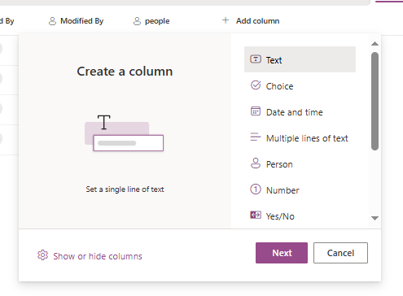
System column
System columns
Notes:
-- 4. Display all Dynamic Columns
DECLARE @ListId INT = 2;
SELECT
dc.ColumnName,
dc.IsVisible,
dc.DisplayOrder
FROM ListDynamicColumn dc
WHERE dc.ListId = @ListId
ORDER BY dc.DisplayOrder;
GO

Slide 40
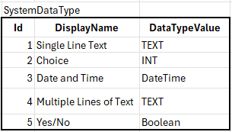
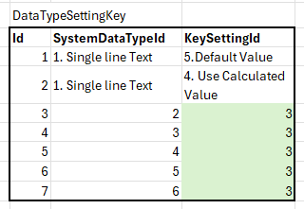
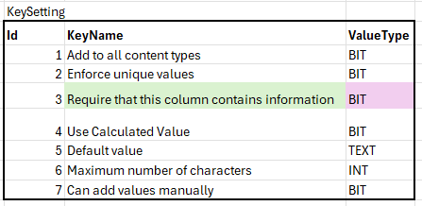
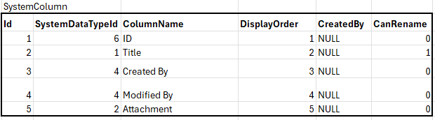
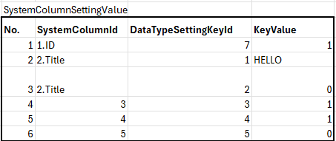
System Column example data

Slide 41
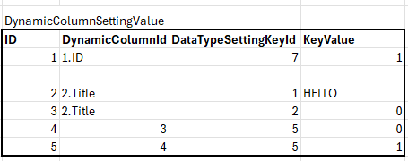
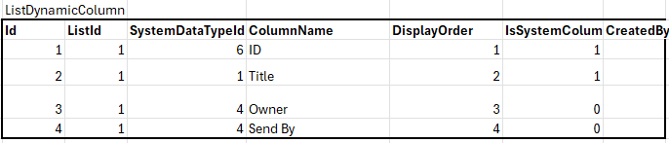
Dynamic Column example data

Slide 42
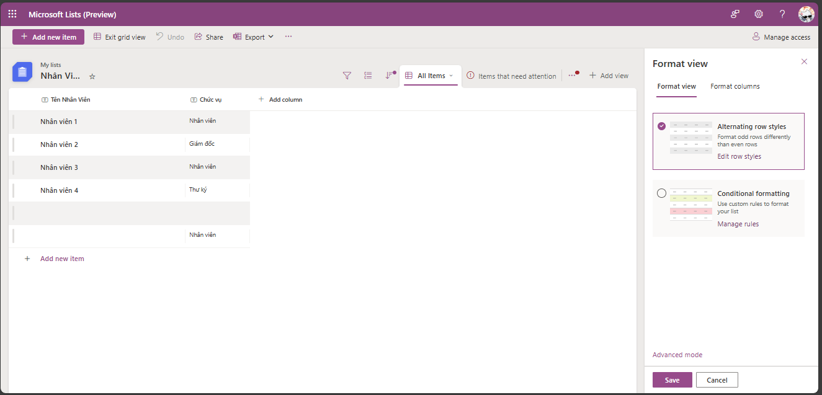
Format View

Slide 43
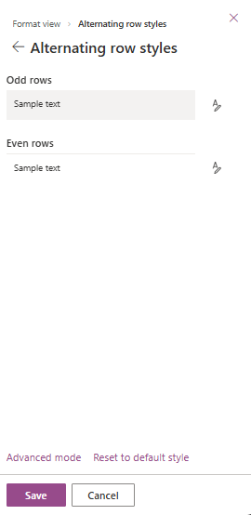
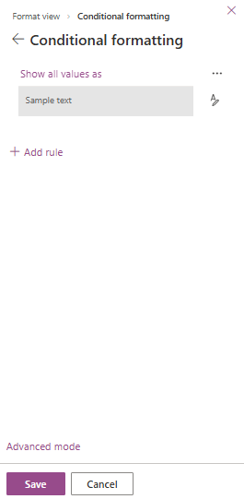
Format View

Slide 44
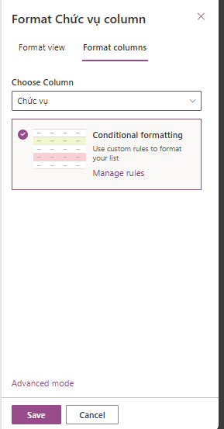
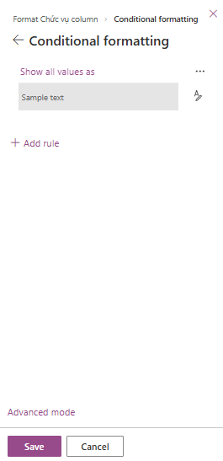
Format Column

Slide 45
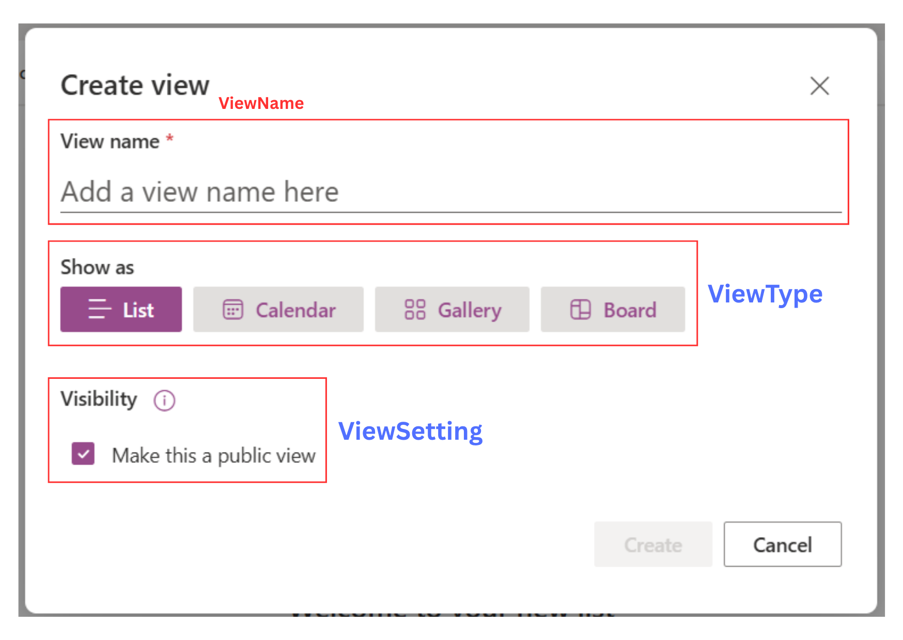
List View

Slide 46
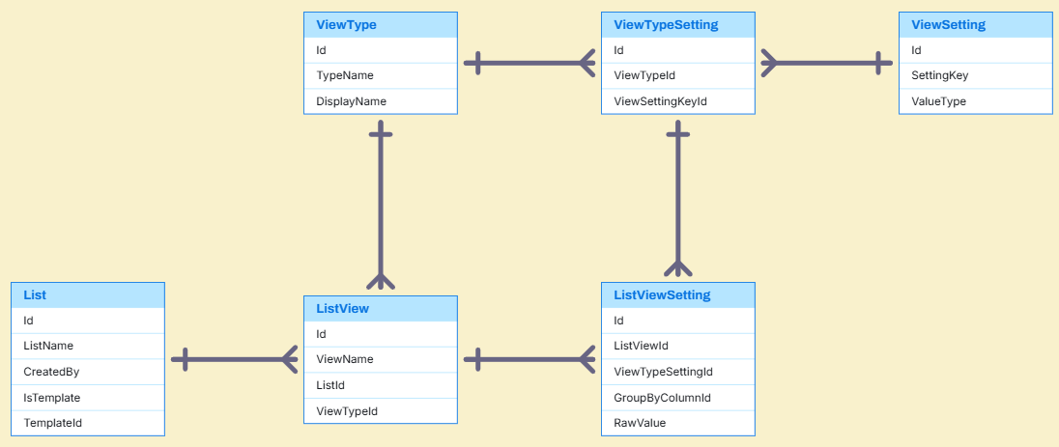
List View Entities

Slide 47
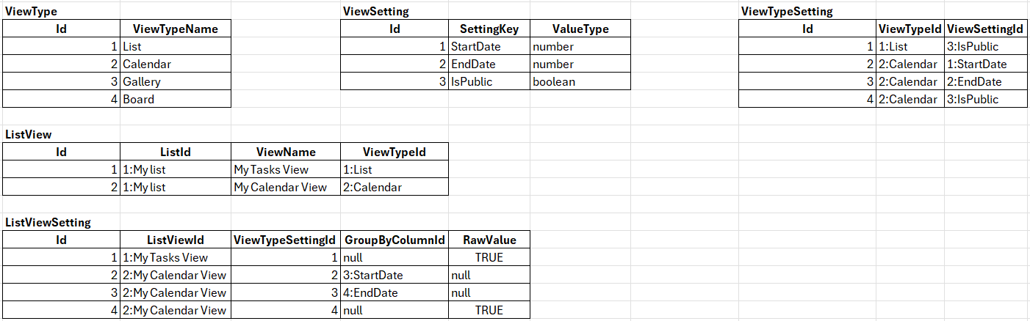
List View Sample Data

Slide 48
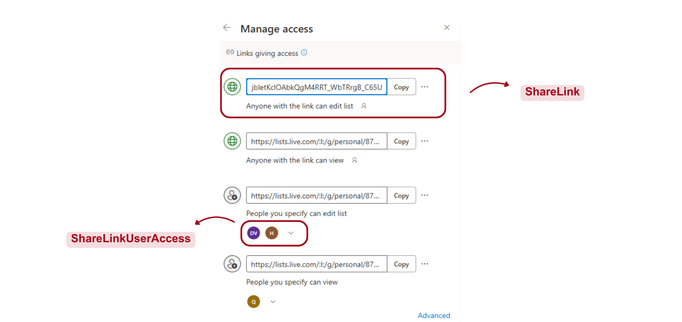
Manage Access

Slide 49
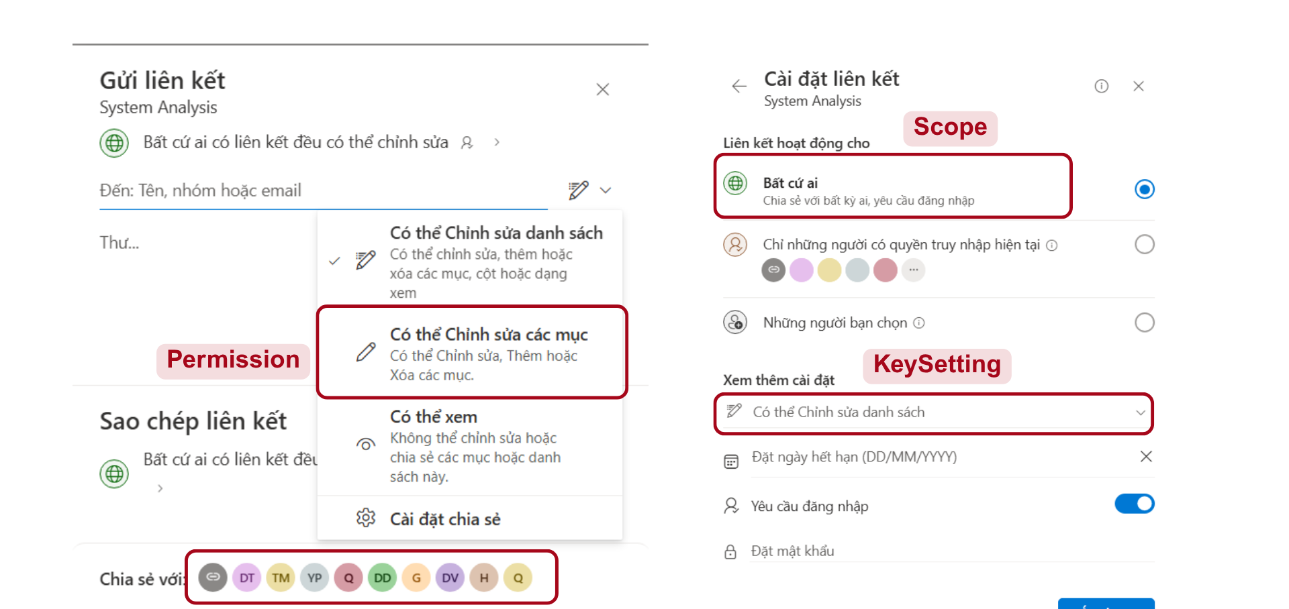
Manage Access

Slide 50

Manage Access Entities

Slide 51

Manage Access Sample Data

Slide 52

Trash

Slide 53
Q&A

